Slide 1
ECE901: Part 2

Slide 2
Dimitris Papailiopoulos
Advances and Challenges in Distributed Machine Learning

Slide 3
Mostly Challenges

Slide 4
Overview
Multicore vs. Distributed
Algorithms of choice
Open challenges with Performance Gains/Analysis
Convergence/Generalization/Speedup/Delays?
Straggler Nodes
Adversarial attacks

Slide 5
Stochastic Gradient Descent
Different names and flavors
ML / Optimization / Statistics / EE
Perceptron
Incremental Gradient
Back Propagation (NNs)
Oja’s iteration (PCA)
LMS Filter
…
Has been around for a while, for good reasons:
Robust to noise
Simple to implement
Near-optimal learning performance *
Small computational foot-print
Idea (‘50s, ‘60s [Robbins, Monro], [Widrow, Hoff]):
Sample a data point + locally optimize.
loss for data point i
SGD: An Über-algorithm

Slide 6
Stochastic Gradient Descent
SGD can take 10+ days on large data sets
[DawnBench, 2017]
Goal:
Speed up Machine Learning

Slide 7
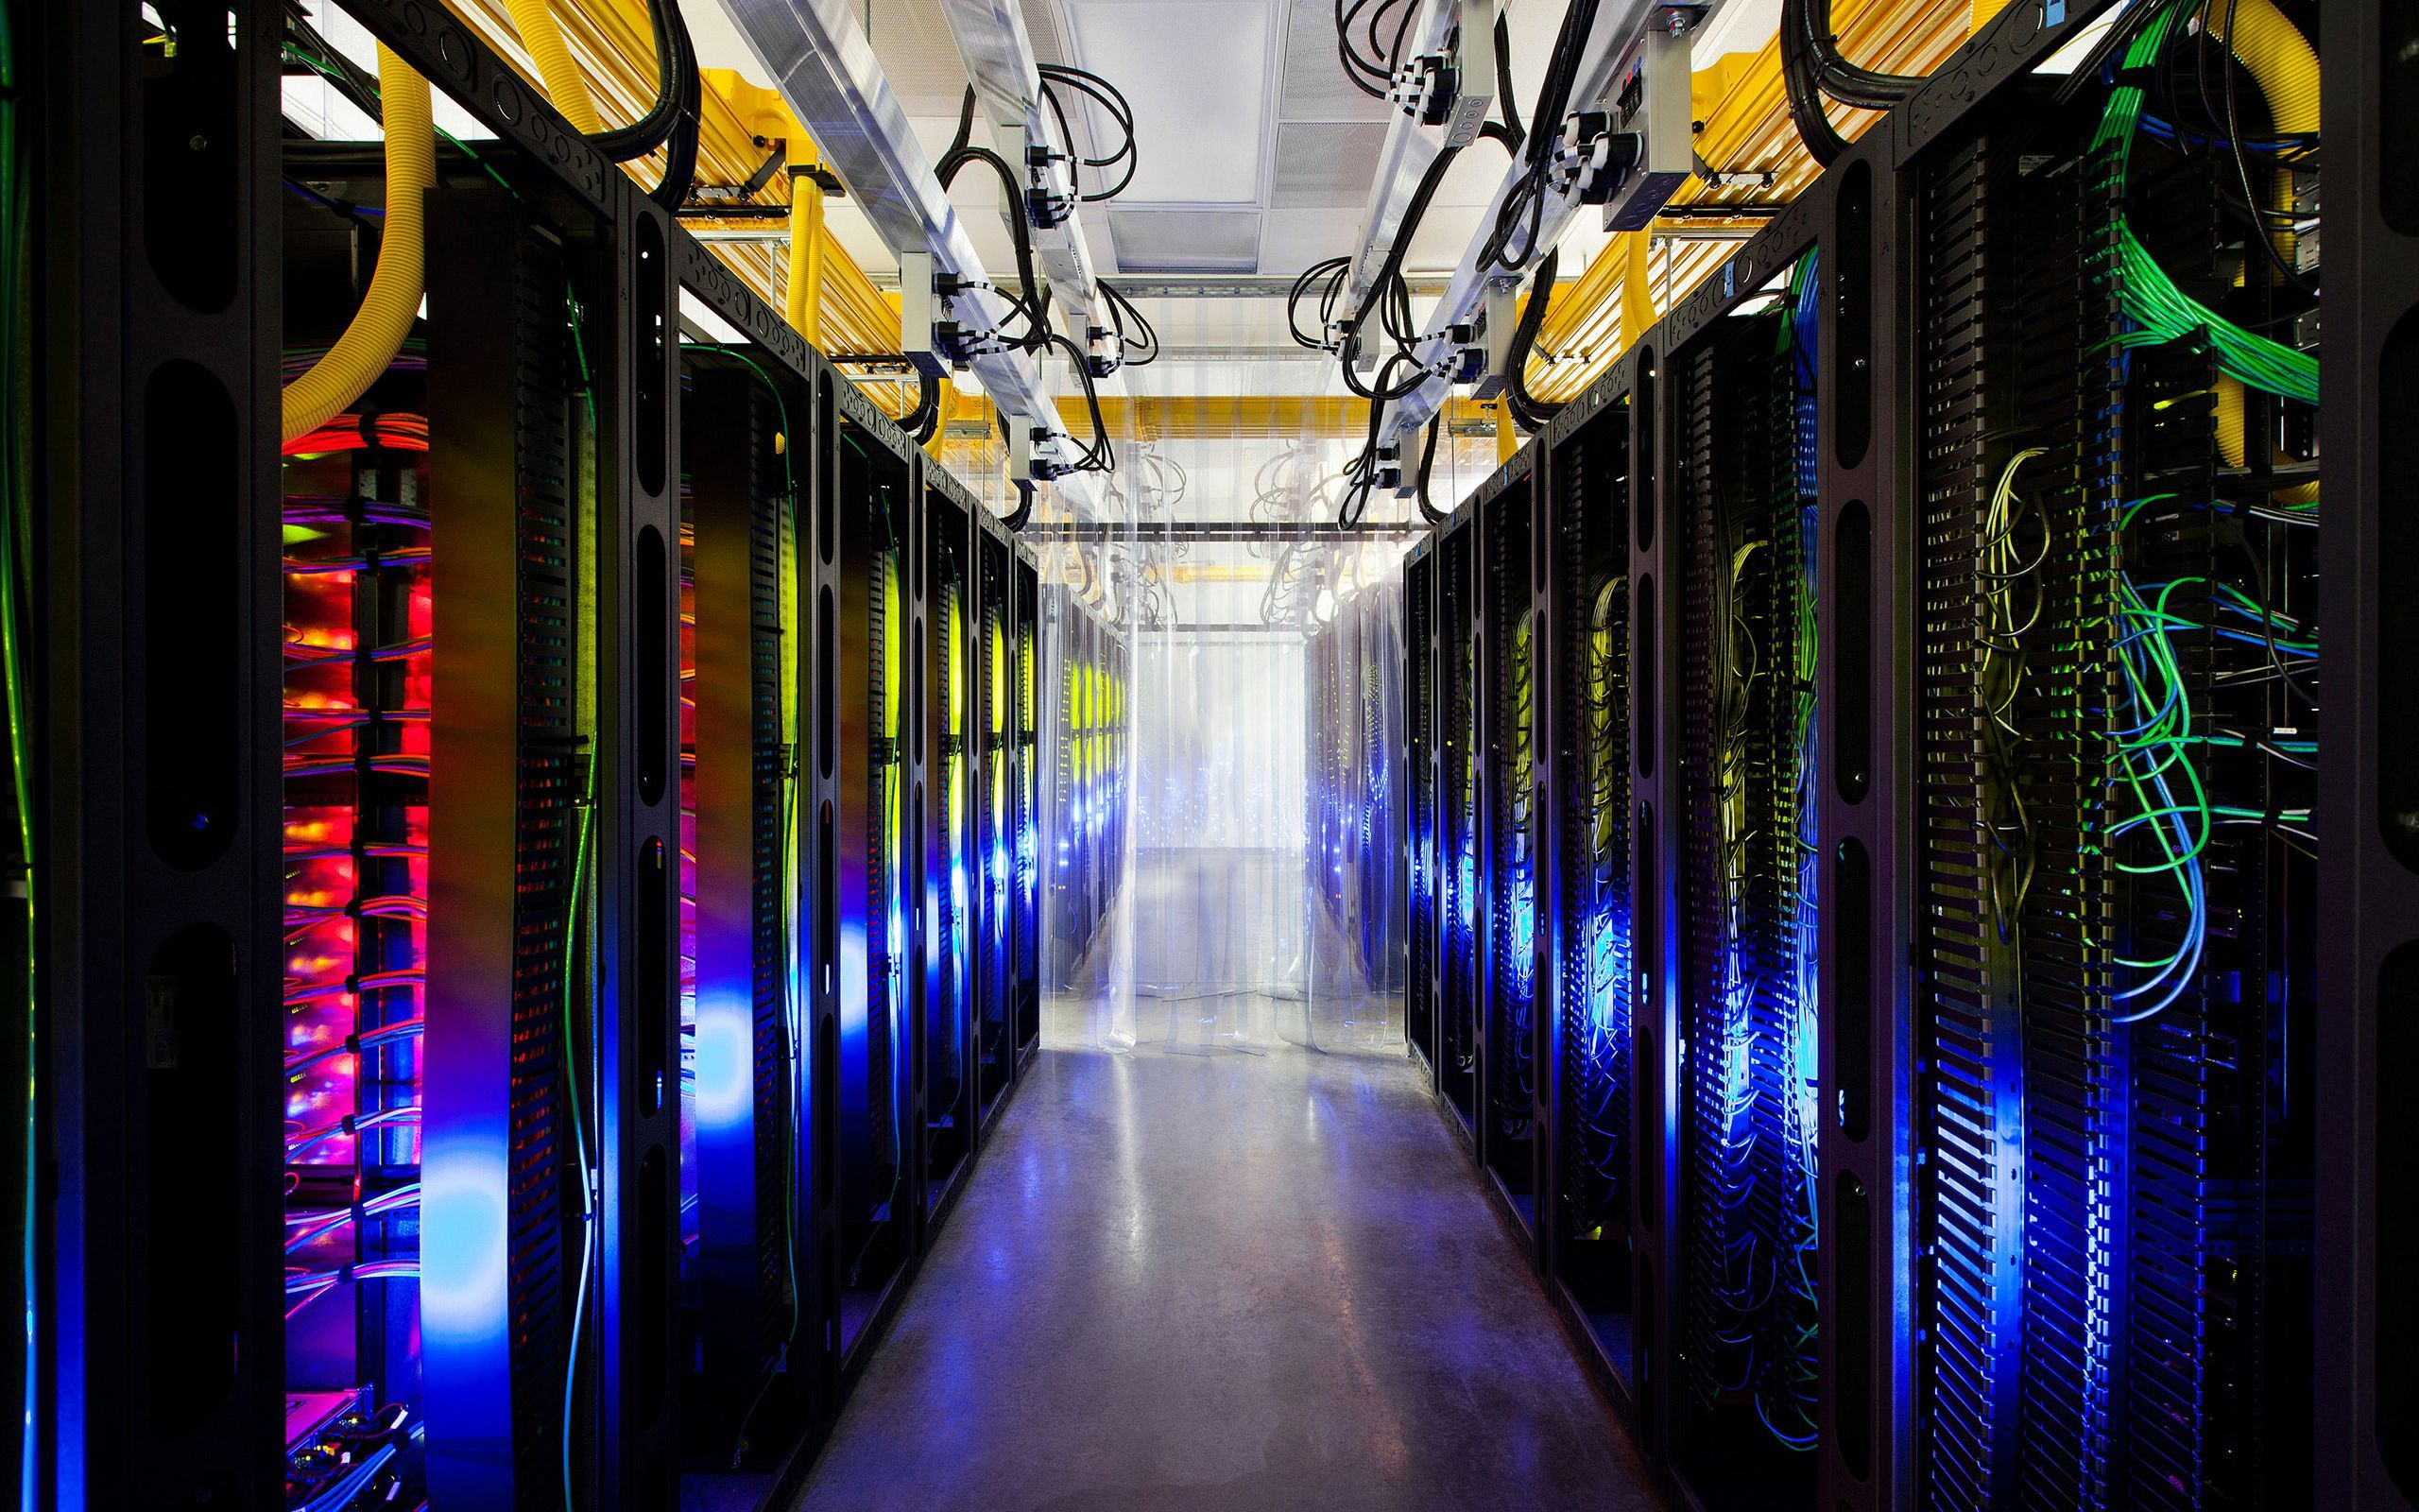
Idea:
Train at scale

Slide 8
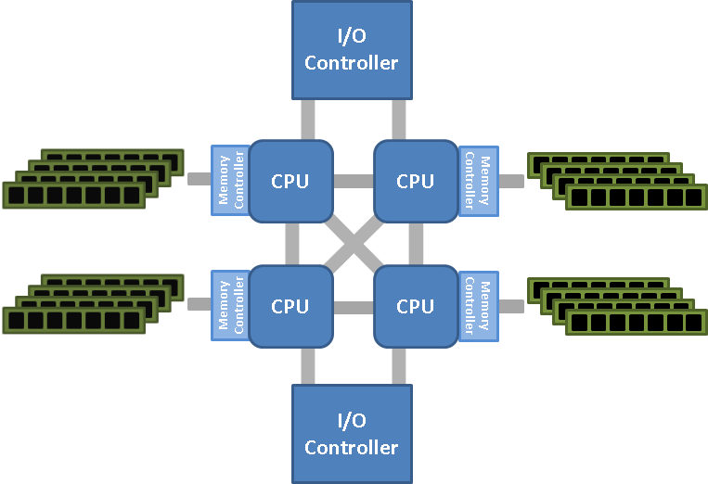
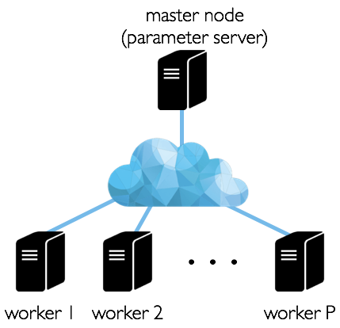
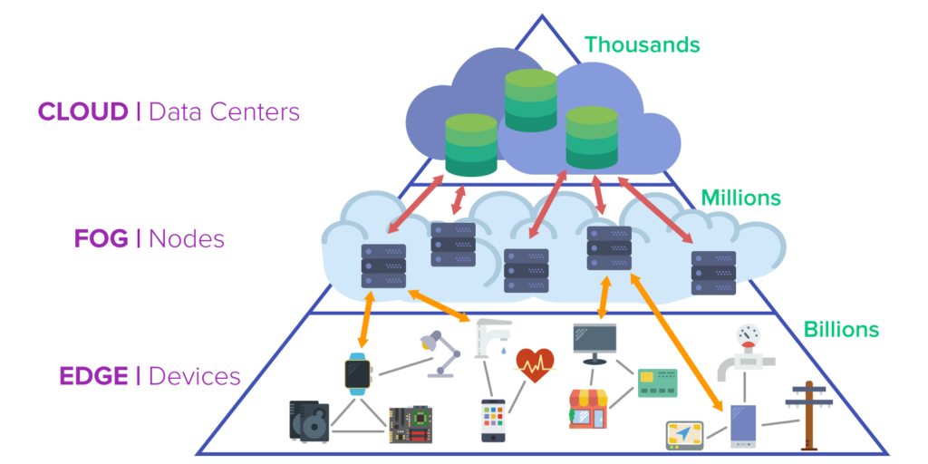
Platforms
Parallel
Single machine, multicore
Multi-socket NUMA
Distributed

Slide 9
Parallel vs. Distributed
Parallel (CPU)
Single machine, many cores (usually up to100s)
Shared memory (all cores have access to RAM)
Comm. to RAM is cheap
Distributed
Many machines (usually up to1000s) connected via network
Shared-nothing architecture (each node has its own resources)
Communication costs non-negligible
Scaling up vs. Scaling out

Slide 10
Scaling up vs. out
What we’d ideally like
Cores
RAM
Comm. Cost
Cost to build
Feasible solutions:
Scaling up:
Getting the largest machine possible, with maxed out RAM
Scaling out:
Getting a bunch of machines, and linking them together

Slide 11
Scaling up vs. out
Scaling up
Pros:
RAM comm. cheap (no network)
Less impl. overheads
Less power/smaller footprint
Cons:
100s cores/machine = expensive
Smaller fault tolerance
Limited upgradability
Scaling out
Pros:
Much cheaper (especially on Ec2)
Can replace faulty parts
Better fault tolerance (if it matters)
Cons:
Network bound
Major implementation overheads
Large power footprint

Slide 12
Choosing your Hardware

Slide 13



Price Comparisons for 4 GPUs racks
Single machine multi-core (CPU)
For 4 Tesla V100 GPU work station:
Alternative Choice: Rent instances
more than $60,000

Slide 14
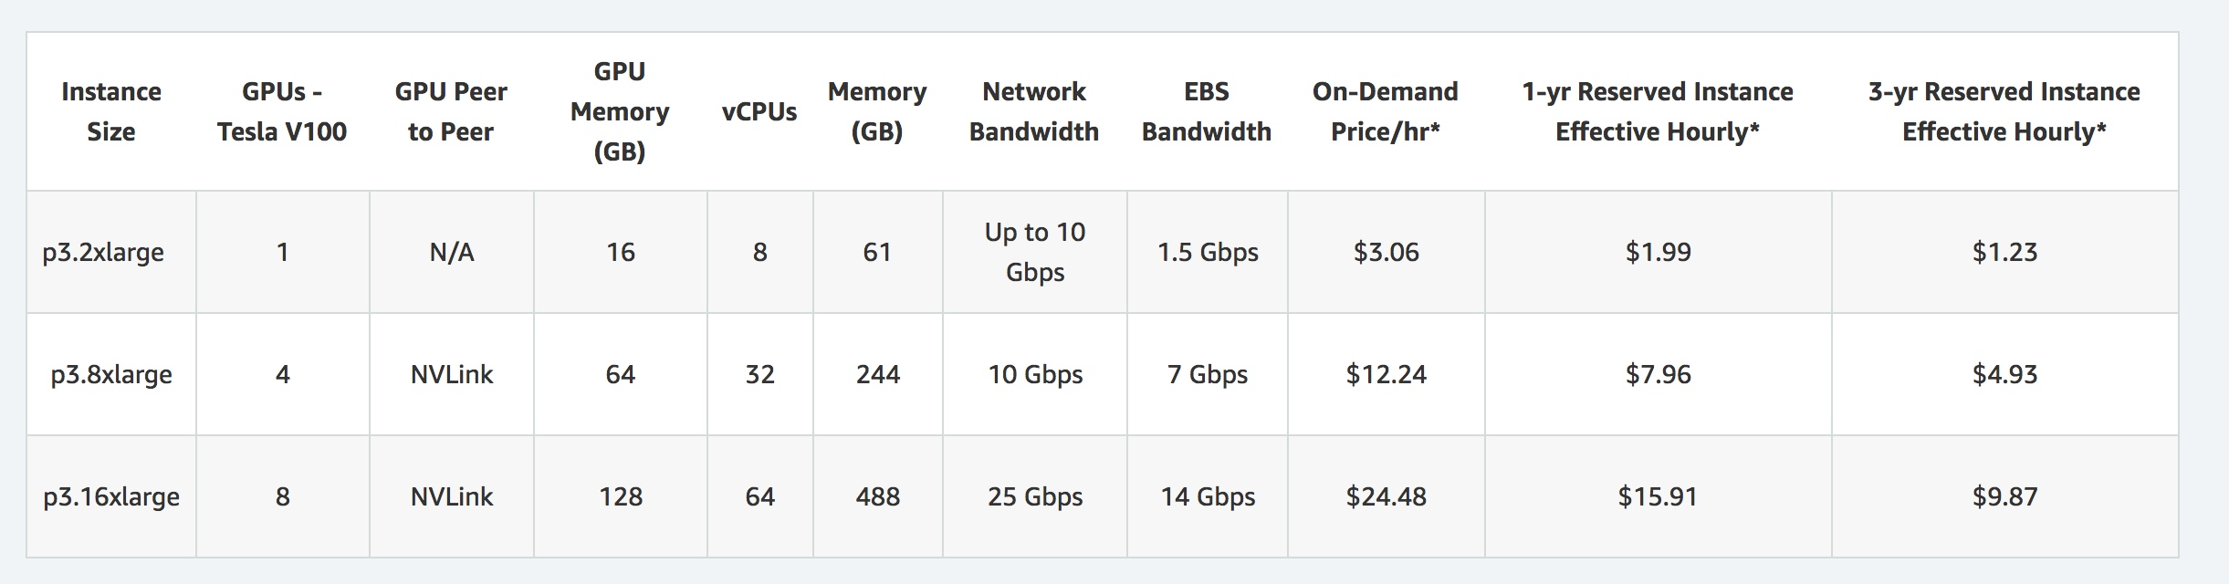
EC2 Price for Scaling-up to 128 cores
Alternative Choice: Rent Instances
Price for 4 GPUs: $8/hr 10 days nonstop/month, for a year ~ $23,000
Deciding on HW is a lot of work

Slide 15
Let’s Think about Running Stuff

Slide 16
How to Parallelize
Parallelize computation of one update?
Issue:
computing cheap (even for deep nets) [ O(d) ]
Parallel Updates?
Issue: SGD is inherently serial….
Q: Can we parallelize inherently serial algorithms?

Slide 17
Simple idea
Compute multiple gradients in parallel
Q: Does it perform the same as SGD?

Slide 18
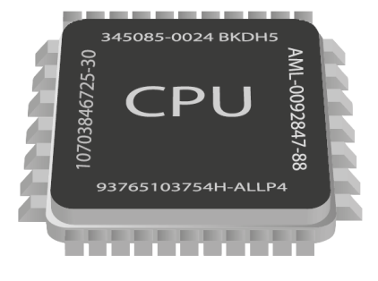









Distribute the effort!
Theory
Many models weaker than one
Delays and Slow Nodes
Communication Costs
Barriers to entry / High Cost
Implementation Overhead
Nontrivial choice of ML-framework
Several issues
Practice

Slide 19
Choosing an Algorithm

Slide 20
The Master-worker Setting

Slide 21
Algorithm of choice: minibatch SGD

Slide 22
Algorithm of choice: minibatch SGD
Stores the model
Gradient Computations

Slide 23
Algorithm of choice: minibatch SGD

Slide 24
Algorithm of choice: minibatch SGD

Slide 25
Algorithm of choice: minibatch SGD

Slide 26
Algorithm of choice: minibatch SGD

Slide 27
Algorithm of choice: minibatch SGD
Repeat distributed iterations until
we are happy with the model

Slide 28
Evaluating the performance of Distributed ML

Slide 29
Many Questions….
How fast does minibatch-SGD converge?
How can we measure speedups?
Comm. is expensive, how often do we average?
How do we choose the right model?
What happens with delayed nodes?
Does fault tolerance matter?

Slide 30
Reality ~100x worse than optimal
Optimal Speed-up
WHY?
“Large Scale Distributed Deep Networks” [Dean et al., NIPS 2012]

Slide 31
Why so slow?
Two factors control run-time
Time to accuracy ε =
[time per data pass] X [#passes to accuracy ε]

Slide 32
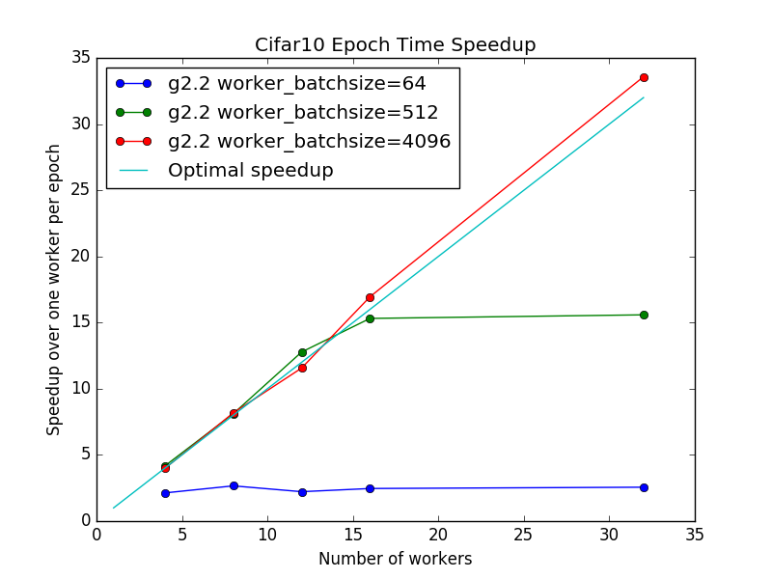

Why so slow?
“[…] on more than 8 machines […]
network overhead starts to dominate […]”
TL;DR: Communication is the Bottleneck
Why?
Time per pass:
time for dataset_size/batch_size distributed iterations
Bigger Batch
Less Communication
(smaller time per epoch)

Slide 33
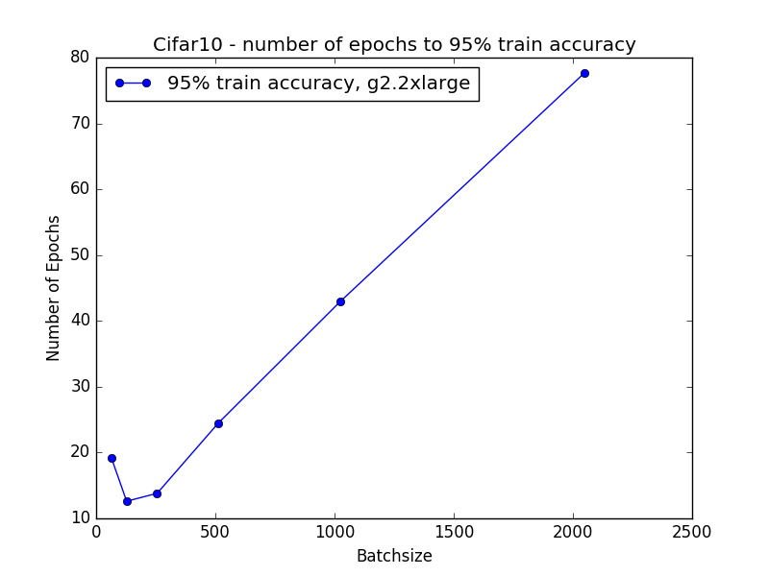
What’s wrong with Large Batches?
- If small batch is bad, then maximize it
Large Batch
worse train error
(more #passes to accuracy ε)
Large Batch
=> worse generalization
[Keskar, Mudigere, Nocedal,
Smelyanskiy, Tang, ICLR 2017]

Slide 34
How to analyze parallel algorithms?
Main measure of performance
Example: Gradient Descent
Embarrassingly Parallel O(#cores) speedup
Serial
Parallel
Not true for mini-batch SGD
- Convergence is invariant of allocation
Both algorithms reach to same accuracy after T iterations
Speedup is independent of covergence rate

Slide 35
How to Analyze mini-batch?
Measure of performance
Main Question:
How does minibatch SGD compare against serial SGD?
Main questions:
Convergence after T gradient computations
Answer is Complicated: Depends on Problem
Generally if batch B_0 > B(data, loss)
Minibatch SGD offers no speedup.

Slide 36
Generalization?
Do models trained with minibatch SGD generalize
Alexnet on Imagenet

Slide 37
Generalization?
Do models trained with minibatch SGD generalize
Major open questions
Large batch vs small batch models

Slide 38
How to chose the right model
Some models are better than others,
even from a systems perspective

Slide 39
How to chose the right model
Some models are better than others,
even from a systems perspective

Slide 40
How to choose the right model
Some models are better than others,
even from a systems perspective
Does it fit in a single machine?
Is model architecture amenable
to low communication?
Some models easier to partition
Can we increase sparsity (less comm)
without losing with accuracy?

Slide 41
How to chose the right model
Some models are better than others,
even from a systems perspective

Slide 42
Parallelism Gains?
Weak Scaling: Easy
Strong Scaling: Nontrivial, and not there yet
Major Open Problem!!!

Slide 43
Avoiding Communication Bottlenecks

Slide 44
Large-scale Distributed Machine Learning Systems
Storage
Communication
Computation
1
Δ
1
Δ
Distributed Data Storage
Δ
2
Δ
2
Aggregator
Data
Δ
Network
Δ
Δ
Δ
n
Δ
n
Δ
Notes:
Large-scale computing systems have 3 main layers: Storage layer, Communication Layer, and Computation Layer. Data is read from the storage layer, and transmitted through the network towards the computing nodes. The new results of computation are then stored again to complete the loop. each of these steps incurs some delay and uncertainty. Can codes robustify algorithms against this system noise?

Slide 45
A better algorithm?
Communication / worker:
O(size of gradient)*32 bits
Q: Lower precision?
O(size of gradient)*4 bits
A: Yes!
A lot of recent work on quantized SGD

Slide 47
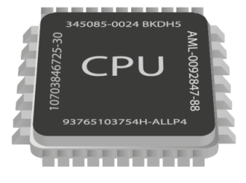
Data Shuffling
Data
Model
Random
SGD
SGD
SGD
Merge models

Slide 48
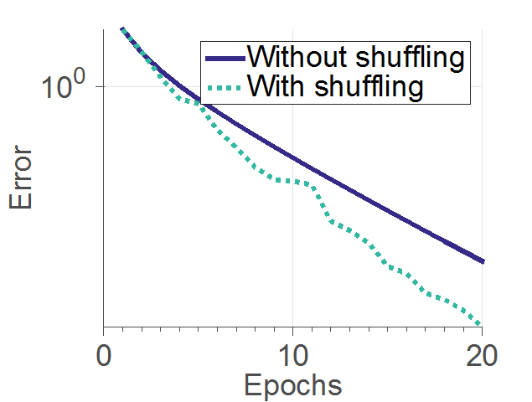
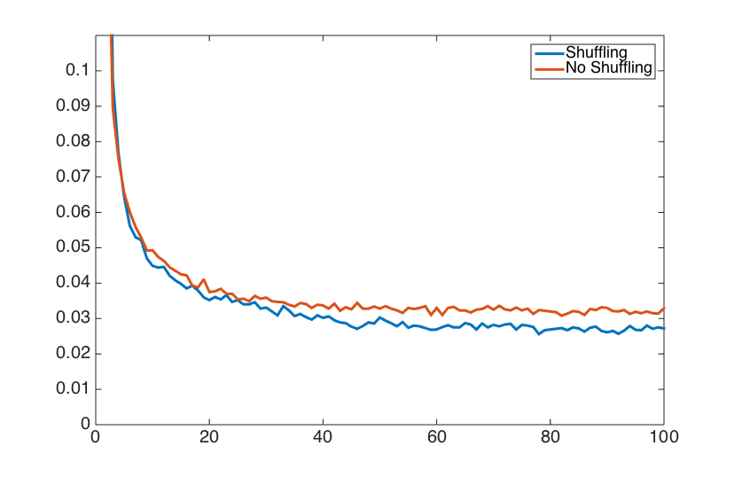
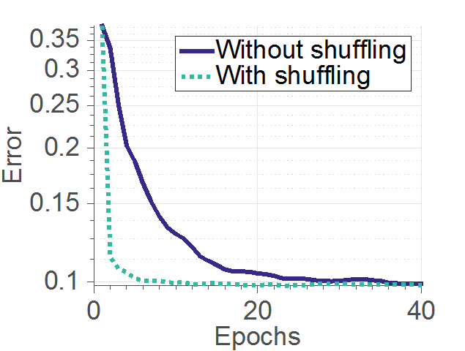
Parallel Stochastic Gradient Descent (PSGD)
Data shuffling
Very high communication cost:
does shuffling still makes sense?
Data
Model
Random
SGD
SGD
SGD
PSGD with shuffling converges faster
Merge models
* [Recht and Re, 2013], [Bottou, 2012], [Zhang and Re, 2014], [Gurbuzbalaban et al., 2015], [Ioffe and Szegedy, 2015], [Zhang et al. 2015]

Slide 49
As if the Design landscape was not complicated enough…
How can we mitigate Delays and Straggler Nodes?

Slide 50
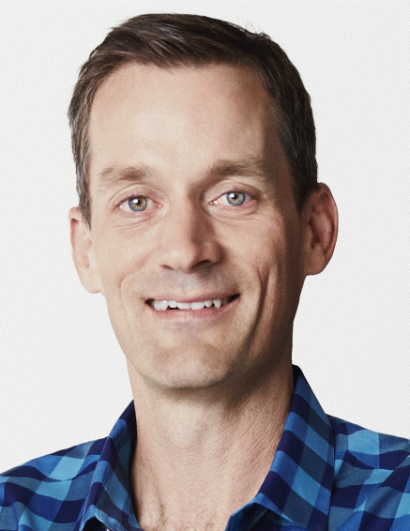
Large-scale Distributed Machine Learning Systems
Storage
Communication
Computation
1
Δ
1
Δ
Distributed Data Storage
Δ
2
Δ
2
Aggregator
Data
Δ
Network
Δ
Δ
Δ
n
Δ
n
Δ
“The scale and complexity of modern Web services make it infeasible to eliminate all latency variability.”
Jeff Dean, Google.
Notes:
Large-scale computing systems have 3 main layers: Storage layer, Communication Layer, and Computation Layer. Data is read from the storage layer, and transmitted through the network towards the computing nodes. The new results of computation are then stored again to complete the loop. each of these steps incurs some delay and uncertainty. Can codes robustify algorithms against this system noise?

Slide 51


Bottleneck 2: Straggling Learners
model
model
model
model
model
Can we “robustify” distributed ML
against stragglers?
Measured on Amazon AWS

Slide 52
A case against Synchronization
overheads
timeline
CPU 1
CPU 2
CPU 3
stragglers
Asynchronous World
CPU 1
CPU 2
Faster
CPU 3
Easier to Implement

Slide 53
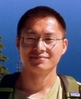




HOGWILD! 2011
“Run parallel lock-free SGD without synchronization”
Niu
Recht
Ré
Wright
SVM RCV1 (10 cores)
Each processor in parallel
Impact
Downpour SGD, Project Adam use HOGWILD!
Renewed interest on async. optimization

Slide 54

Challenges in Hogwild!
Shared Memory
Processor 1
Issues:
- updates can be old
results can overwritten
Speedup saturation
no “reproducibility”
Processor 2
Processor P
Convergence analysis is usually a pain

Slide 55
A case against Asynchronoys
Serializability:
Hogwild Model ≠ SGD Model

Slide 56
Distributed edge ML

Slide 57
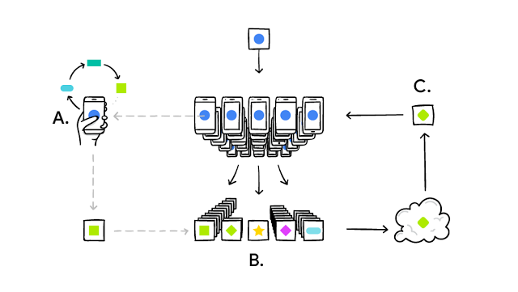
Federated Learning
Several issues:
Privacy
Scaling
Power consumption

Slide 58
Robustness during inference

Slide 59
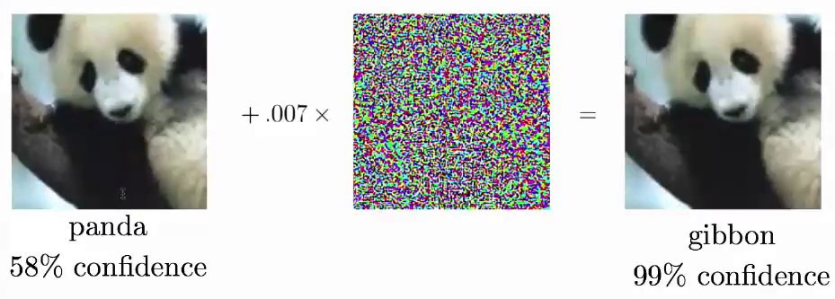
The Failures of Deep Learning
WHY?

Slide 60
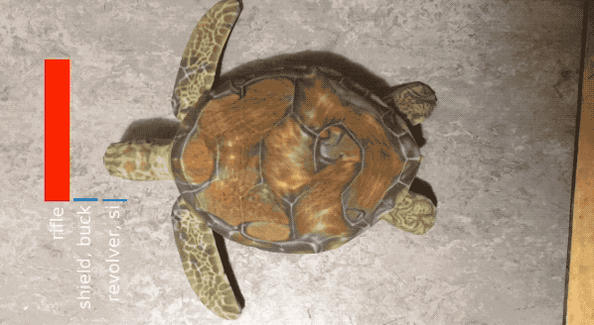
The Failures of Deep Learning
WHY?

Slide 61
Robustness during training

Slide 62
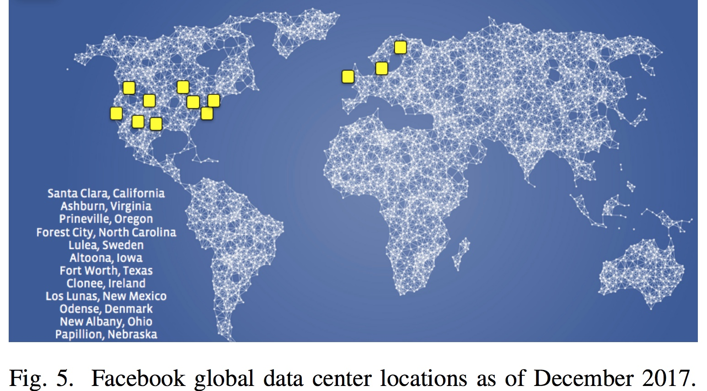
Robustness: a key Challenge
“For […] training and inference […] the importance of disaster-readiness cannot be underestimated.”
“Adversaries are constantly searching for new […] ways to bypass our identifiers […]”
Applied Machine Learning at Facebook: A Datacenter Infrastructure Perspective [fb, HPCA2018]

Slide 63


is SGD Robust?

Slide 64
is SGD Robust?

Slide 65
minibatch SGD is not Robust
Can we build a robust version of SGD that is:
+ cheap
+ easy convergence
+ vanilla SGD model = robust SGD model
Lemma:
A single adversary can arbitrarily corrupt the model, even if it’s sending the “correct” direction update.

Slide 66
What’s coming next
Understanding mini-batch SGD performance
Hogwild and theoretical challenges
Serializable + asynchronous SGD algorithms
QSGD and low communication schemes
Straggler Nodes and ways to overcome them
Adversarial attacks, why they happen, how to defend

Slide 67

You want to be here
Optimization
Info/Coding
Theory
Distributed
Systems

